Slide 1
Airline Reservation System

Slide 2
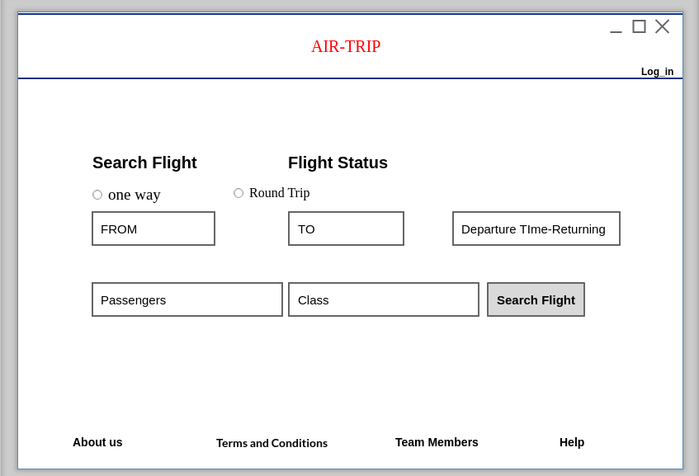
Home Page
1.User have option on home page to check or search flights.
Book Flight

Slide 3
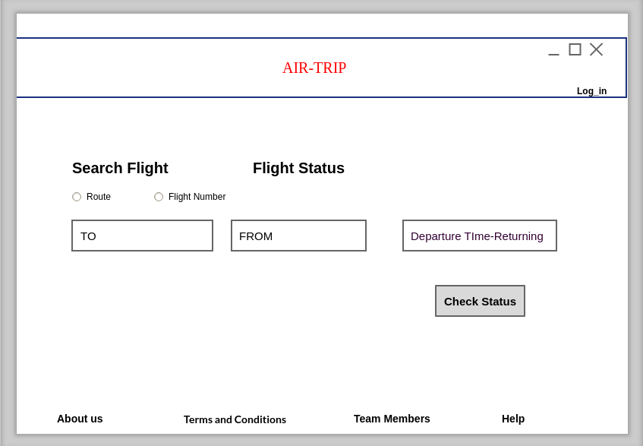
2.User can check flight status
Book Flight

Slide 4
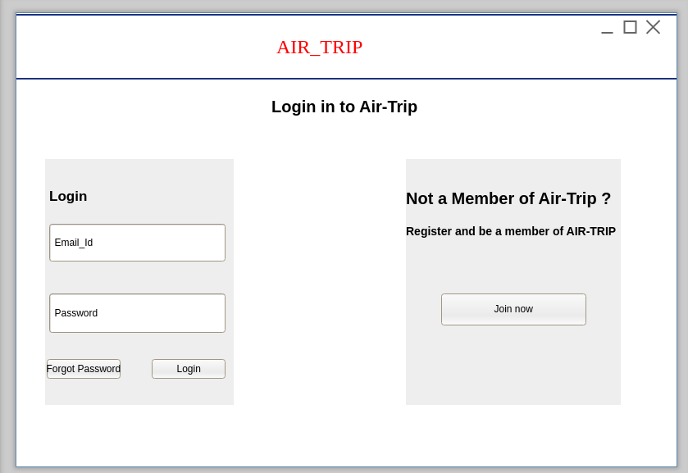
Login page
User want to book flight then need to login first.

Slide 5
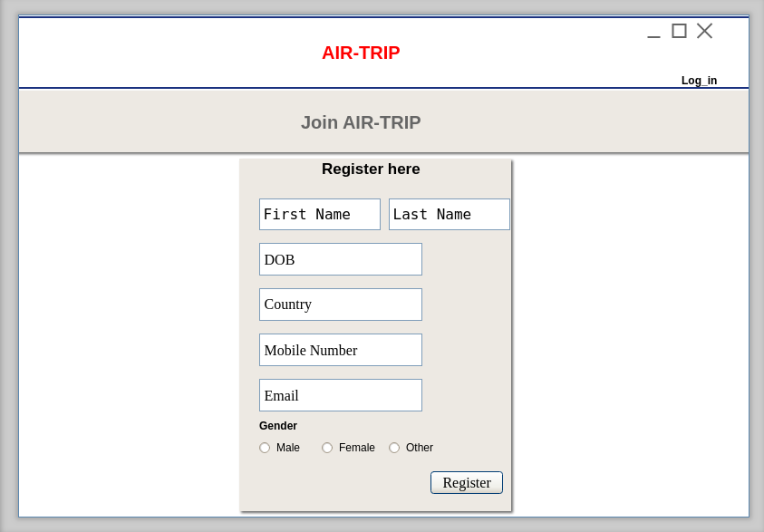
Registration
If user not member of ARS then user need to register for book flights.

Slide 6
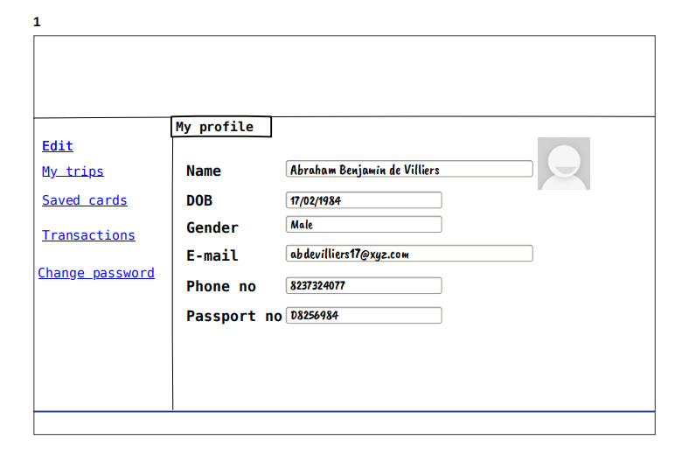
User profile page after login
Book Flight

Slide 7
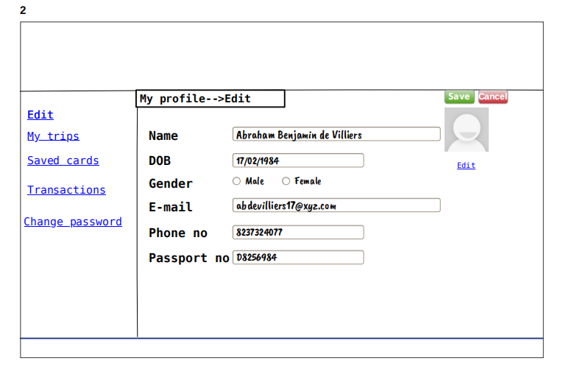
User can edit profile detail.
Book Flight

Slide 8
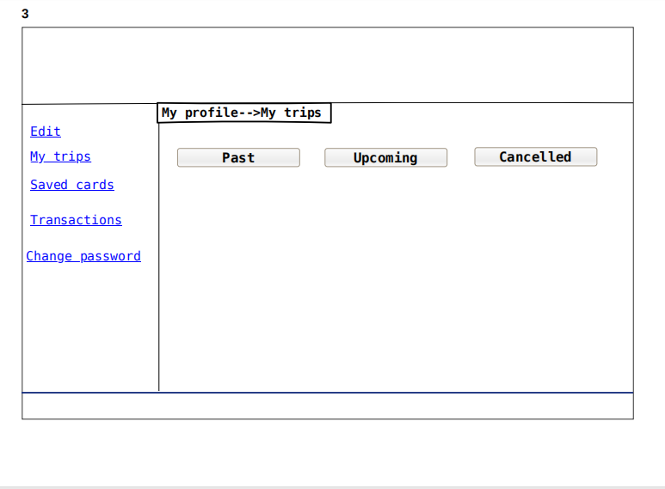
Logs of Trip done by passenger/customer.
Book Flight

Slide 9
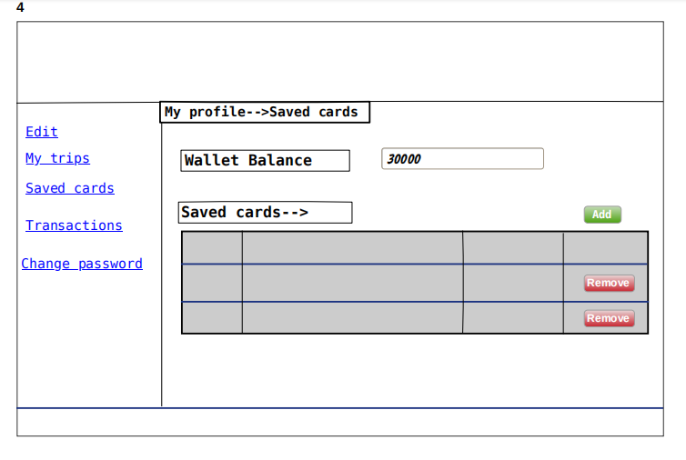
Saved cards for payment.
Book Flight

Slide 10
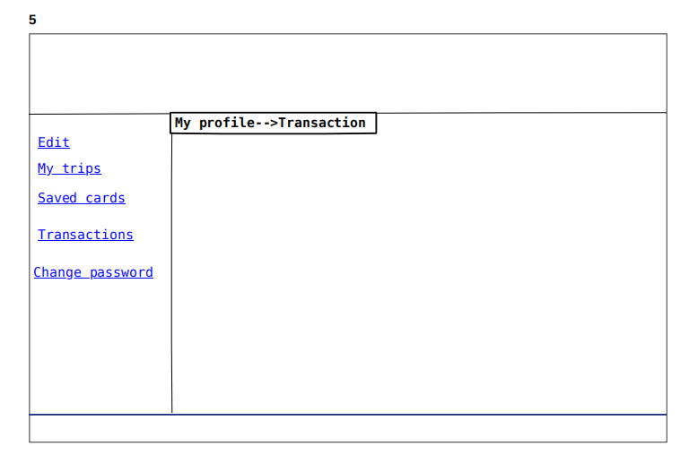
Transaction or payment history.
Book Flight

Slide 11
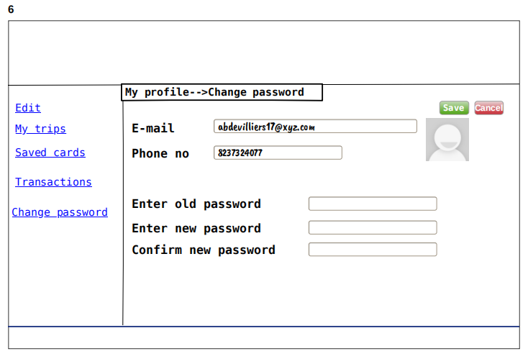
Change password
Book Flight

Slide 12
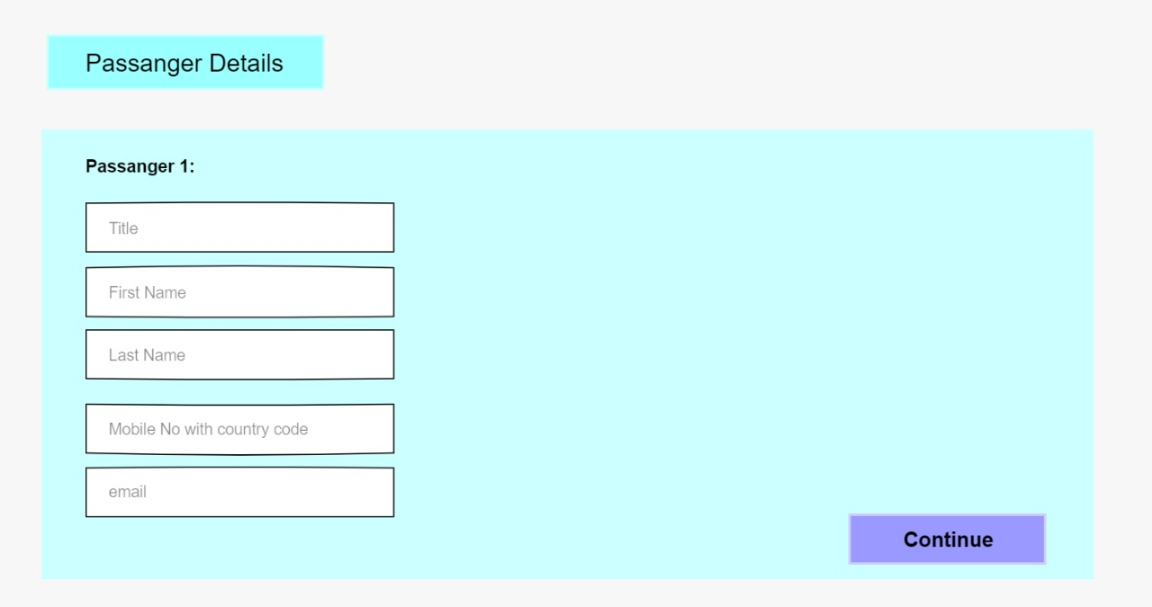
Book Flight
Passport Number
Aadhar Number
Age

Slide 13
Available seats 1-Filled Seats. 0-Remain Seats.
Window seats | Side seats | Side seats | Window seats
0 | 0 | 0 | 0
1 | 0 | 1 | 0
1 | 1 | 1 | 1
0 | 0 | 0 | 0
0 | 1 | 0 | 1
0 | 0 | 0 | 0
0 | 1 | 0 | 1
1 | 0 | 1 | 0
0 | 1 | 0 | 1

Slide 14
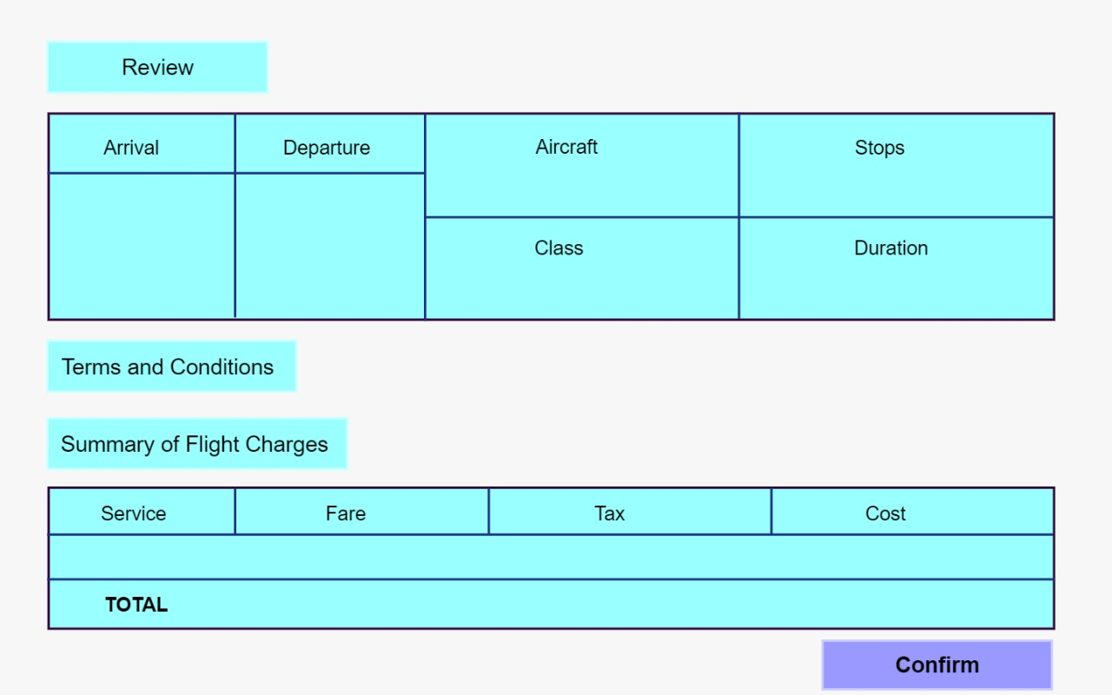

Slide 15
